Slide 1


AI-Powered Customer Churn Prediction for Energy Sector
Discover how AI can revolutionize customer retention in the energy sector. Our predictive model identifies at-risk customers. This enables proactive interventions and reduces churn. Learn about our technology stack and methodology. Explore the impactful benefits for your business.
By Deepak Avachitkar

Slide 2


Addressing High Customer Churn
The Challenge
Customer churn is a significant problem in the energy sector. It impacts revenue and profitability.
Traditional Approaches
Traditional methods are often reactive and ineffective. They fail to identify at-risk customers early.
Our Solution
Our AI-powered model predicts churn with high accuracy. It allows for proactive engagement.

Slide 3





AI-Driven Predictive Model
Python
Sklearn
SHAP
Primary programming language for model development.
Machine learning library for model building.
Explainable AI to understand feature importance.
Power BI
Data visualization for actionable insights.
Our model leverages Python and Sklearn. SHAP values offer explainability. Power BI provides insightful visualizations.

Slide 4


Model Development and Methodology
1
Feature Selection
Identify relevant variables from customer data. Reduce noise and improve model accuracy.
2
Classification Model
Use Random Forest/XGBoost for prediction. Ensure high accuracy and robustness.
3
Training and Testing
Split data into training and testing sets. Optimize model parameters for best performance.
4
Validation
Validate the model against unseen data. Confirm the reliability of the predictions.

Slide 5









Impact and Benefits
Reduced Churn
Improved Retention
Lower churn rates improve profitability.
Effective strategies enhance customer loyalty.
Increased Revenue
Targeted Offers
Retained customers drive higher revenue streams.
Personalized interventions address specific needs.

Slide 6




Enhanced Customer Retention Strategies
Proactive Communication
Reach out before churn occurs
Personalized Offers
Tailor incentives to individual needs
Build Relationships
Foster trust and loyalty

Slide 7
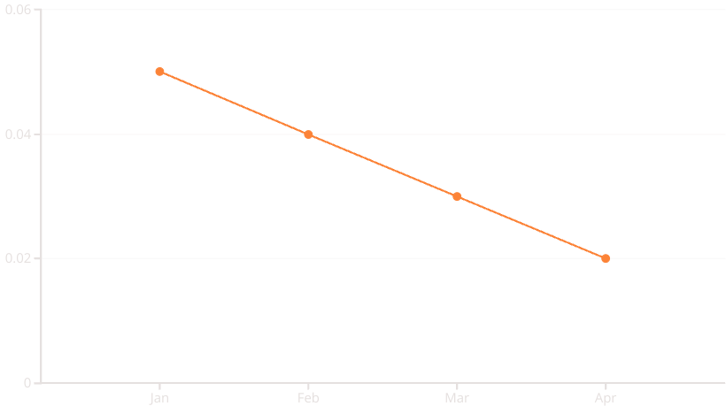

Real-Time Monitoring and Analysis
Real-time monitoring enables immediate action. Identify trends and patterns as they emerge. Proactive intervention prevents churn.

Slide 8





Conclusion and Future Scope
Real-time Monitoring
Implement continuous data tracking.
Model Improvements
Refine algorithms for accuracy.
Expand Data Sources
Incorporate more relevant data.
Integration
Integrate AI into existing systems.
AI-powered churn prediction offers substantial benefits. Continuous model improvement maximizes its value. Embracing these strategies secures customer retention.

